Slide 1
PLEASE PRESS F5 or Slide Show / Presentation mode

Slide 2
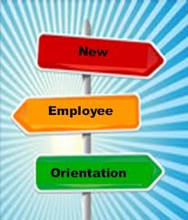
Welcome to CMU!

Slide 3
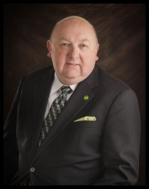
On behalf of the faculty and staff of Central Methodist University, I welcome you! I am excited that you have joined us in our mission to prepare students to make a difference in the world. It takes each and every one of us to create and sustain the community in which we work, a community that can only be described as “a special place”.
We face an exciting time of growth and opportunity on our campus and across our many extended learning sites. I look forward to working with you as we continue the traditions of this extraordinary institution!
Roger Drake, President

Slide 4

Our Mission and Creed
Mission
Central Methodist University prepares students to make a difference in the world by emphasizing academic and professional excellence, ethical leadership, and social responsibility.
Creed
The Central Methodist University community, consistent with its United Methodist heritage, strives for academic excellence, individual achievement, and social responsibility. As members of that community we believe in:
  Seeking knowledge, truth, and wisdom;
  Valuing freedom, honesty, civility, and diversity;
  Living lives of service and leadership; and
  Taking responsibility for ourselves and the communities in which we live.

Slide 5
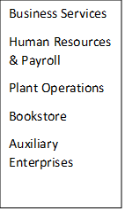
Julee Sherman
VP of Finance and Administration
Chad Gaines
VP of Information Services & Athletics
Dr. Rita Gulstad
Provost
Brad Dixon
VP of Student Development
Dr. Melisssa K. Mace
VP for Enrollment Management
Technology Services
Athletics
Institutional Research
Institutional Planning
Digital University
Technology Services
Athletics
Institutional Research
Institutional Planning
Digital University
CLAS Academics
CGES
Faculty
Registrar
Smiley Library
Correctional Educationarch
Student Development
Student Health
Church Relations
CLAS Admissions
Financial Assistance
Marketing & Communication
Public Relationsevices
Institutional Fundraising
Alumni Relations
Career Services
Ashby Hodge Gallery

Slide 6
CMU is divided into two areas
CLAS – College of Liberal Arts and Sciences
    Located in Fayette at main campus
CGES – College of Graduate & Extended Studies
    14 Locations in Missouri
    Additional sites in Iowa, Arkansas, and Illinois
    Virtual locations On-Line
    All Graduate Assistants

Slide 7

Policy Reminders
All employees should read, understand and comply with all provisions of the Employee Handbook to include:
Code of Business Conduct & Ethics
Nondiscrimination and Harassment Policy
Whistleblower Policy

Slide 8
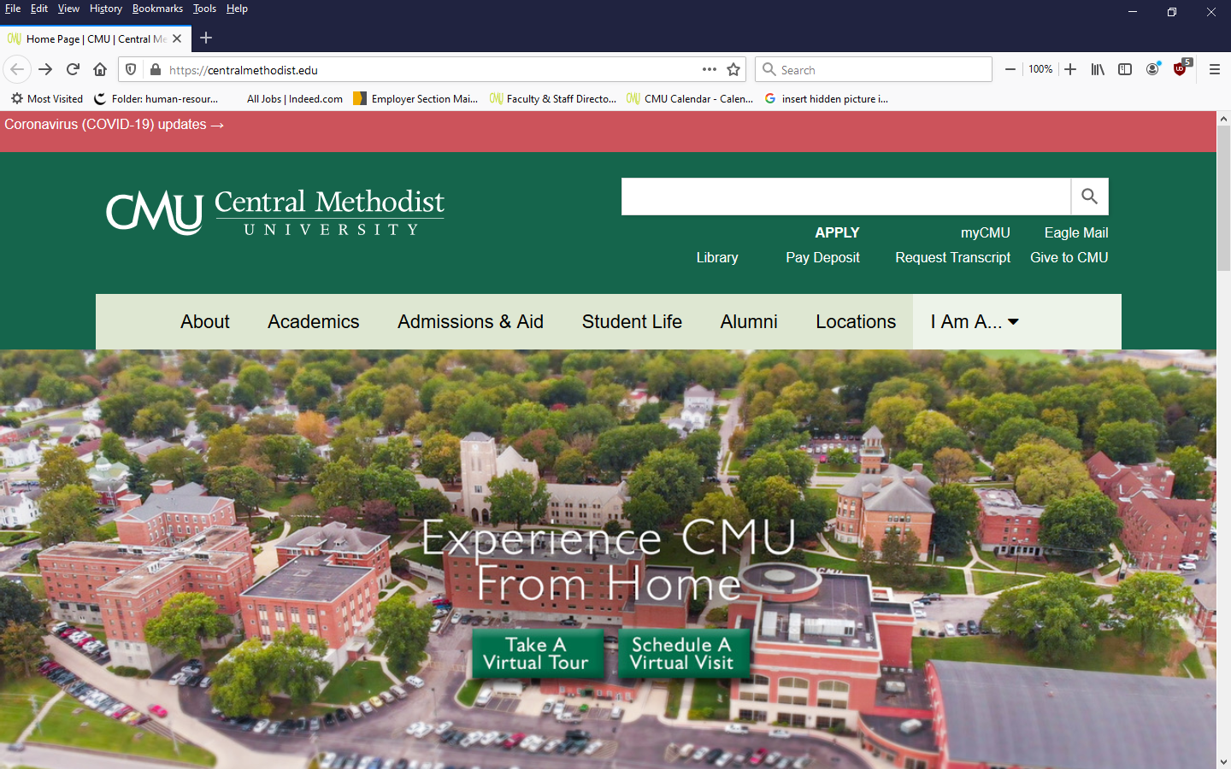
MyCMU

Slide 9
Information found on
MyCMU
Compliance Training
W-2’s
Paystubs
Gift giving and receipts
Student Portals
Access to Zoom
Check receipts from accounts payable
MyCMU Log in will be sent to your immediate Supervisor after you complete the computer user agreement

Slide 10
Annual Compliance Training
FERPA Training
Sexual Harassment – Title IX
Accessable after you receive your log in from IT
  Both trainings to be completed by ALL employees
  Access MyCMU/Convenience Center/Faculty and Staff
  The link for FERPA and Title IX training is at the bottom right

Slide 11
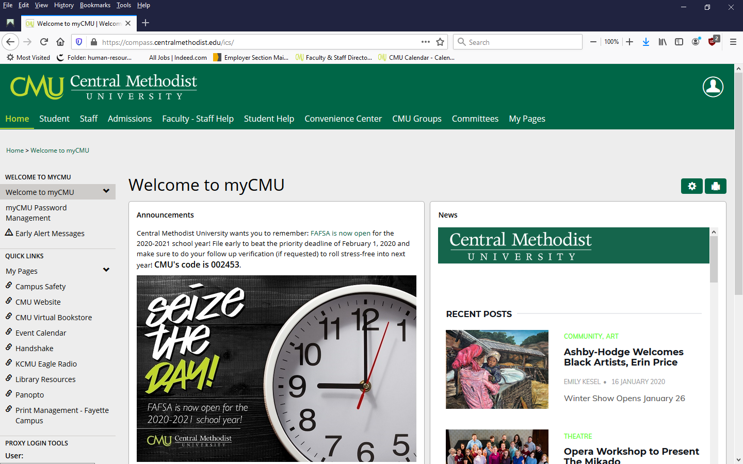

Slide 12
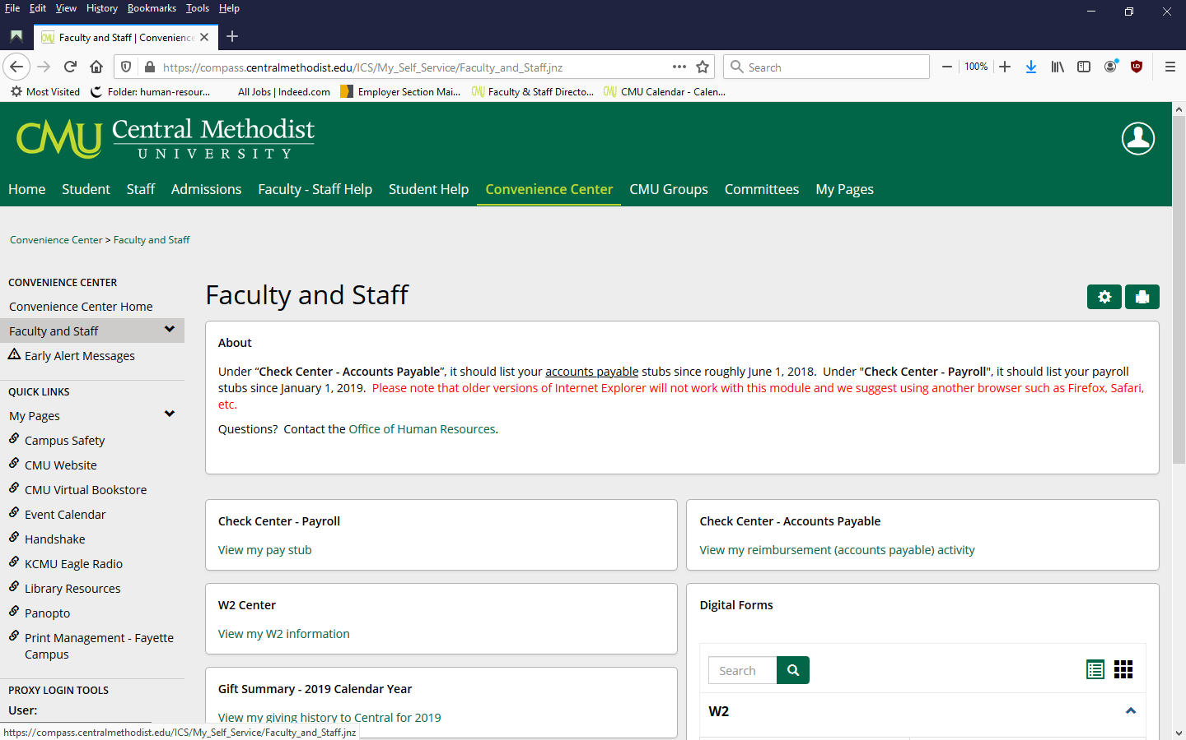
Click Faculty/Staff

Slide 13
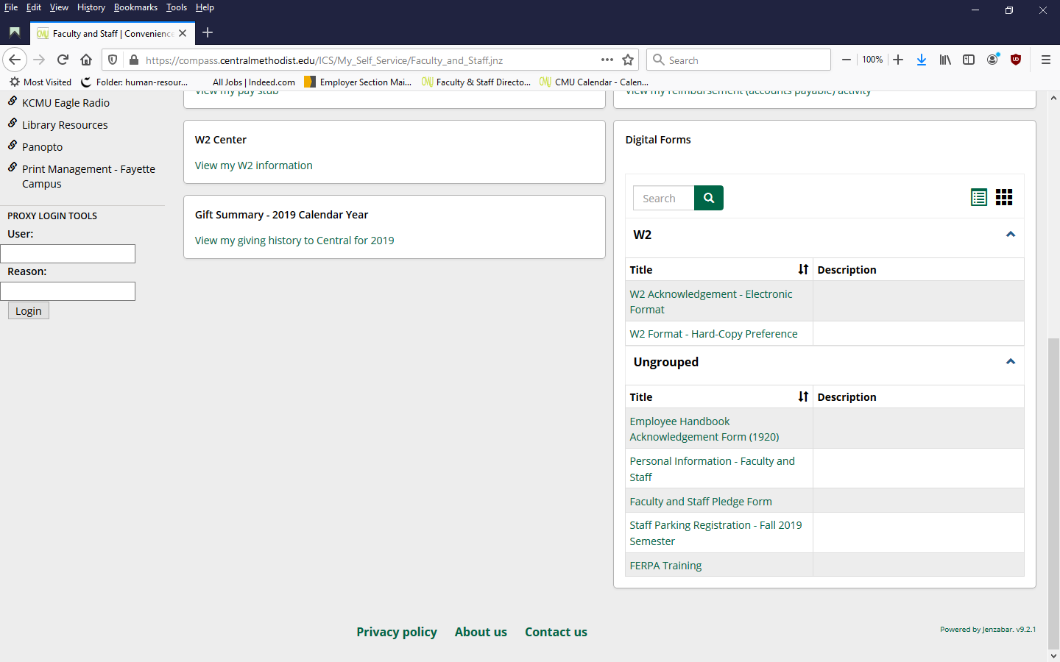

Slide 14
Campus Safety
The safety of students, faculty and staff on CMU property is very important. Please be aware of the tools available to you and what to do in an emergency.
Eagle Alerts (Text CMUAlert to 81437)
Emergency Phones
Emergency Procedure Manual
Title IX and VAWA
To view our Campus Crime Report, visit the Campus Safety page and click on Campus Crime Statistics.
Policy Statement & Procedures

Slide 15
Resources - IT
Complete the Technology User Agreement online and the IT department will set up your email.
Need help with your computer, email, or access to systems? Contact the CMU Helpdesk by:
  Email at helpdesk@centralmethodist.edu (preferred method for faster service)
  Phone at 56197 or 248-6197
Computer User Agreement

Slide 16
Resources-Parking/IDs
Need to know where to park? Visit the parking web page for details.
  Parking permits must be purchased each semester from Donald Clear in the Safety Office. ($25.00/semester)
  No cost options are available, both on campus and street parking.
Need an ID card? Visit the Office of Student Development on the 2nd floor of the Inman Student & Community Center.
  You will need an ID card to attend athletic events and access the exercise facilities. (ID cards are free)

Slide 17
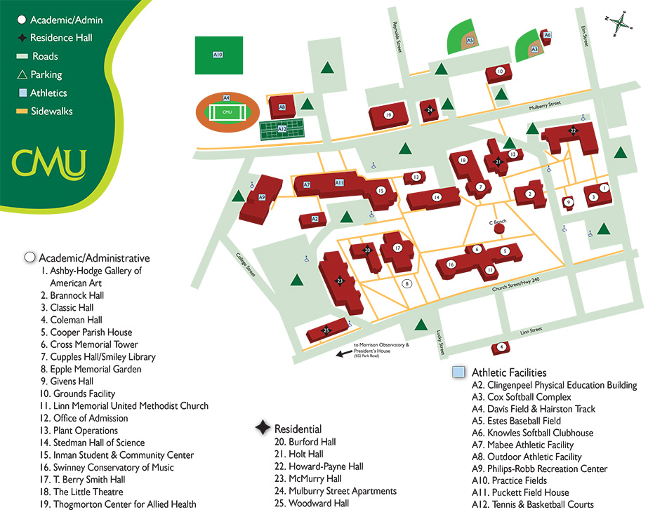
Take a Campus Tour

Slide 18
Timesheets and Vacation
All non-exempt staff employees should be entering their work time into the Time-Clock on the computer every day.
Exempt Staff must log into Time-Clock and log when taking sick or vacation days.
Faculty must log into Time-Clock when using sick days
Plant Operations staff will use current time clock on location, and swipe in and out.

Slide 19
Time Clock located on CMU Website
I AM A FACULTY/STAFF
  Second Blue Box
  TIME CLOCK – EMPLOYEE
SIGN IN THE SAME AS YOUR COMPUTER
  LOG IN - UPON ARRIVAEL
  BREAK OUT / IN FOR BREAKS
  LOG OUT – WHEN LEAVING FOR THE DAY
Employee Timeclock
Example

Slide 20
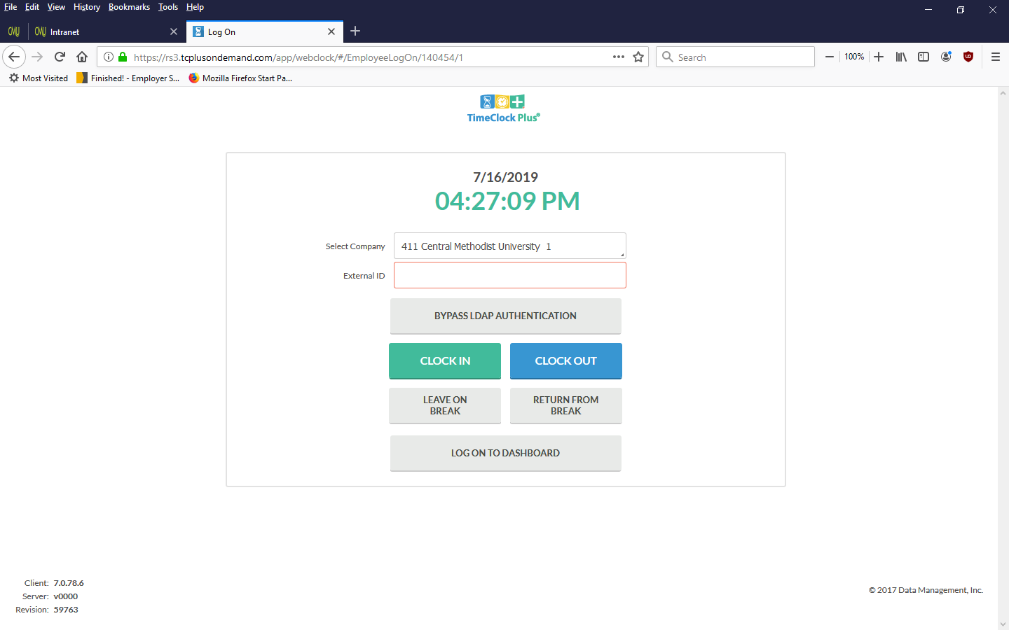
Time Clock will look like this:
Back

Slide 21
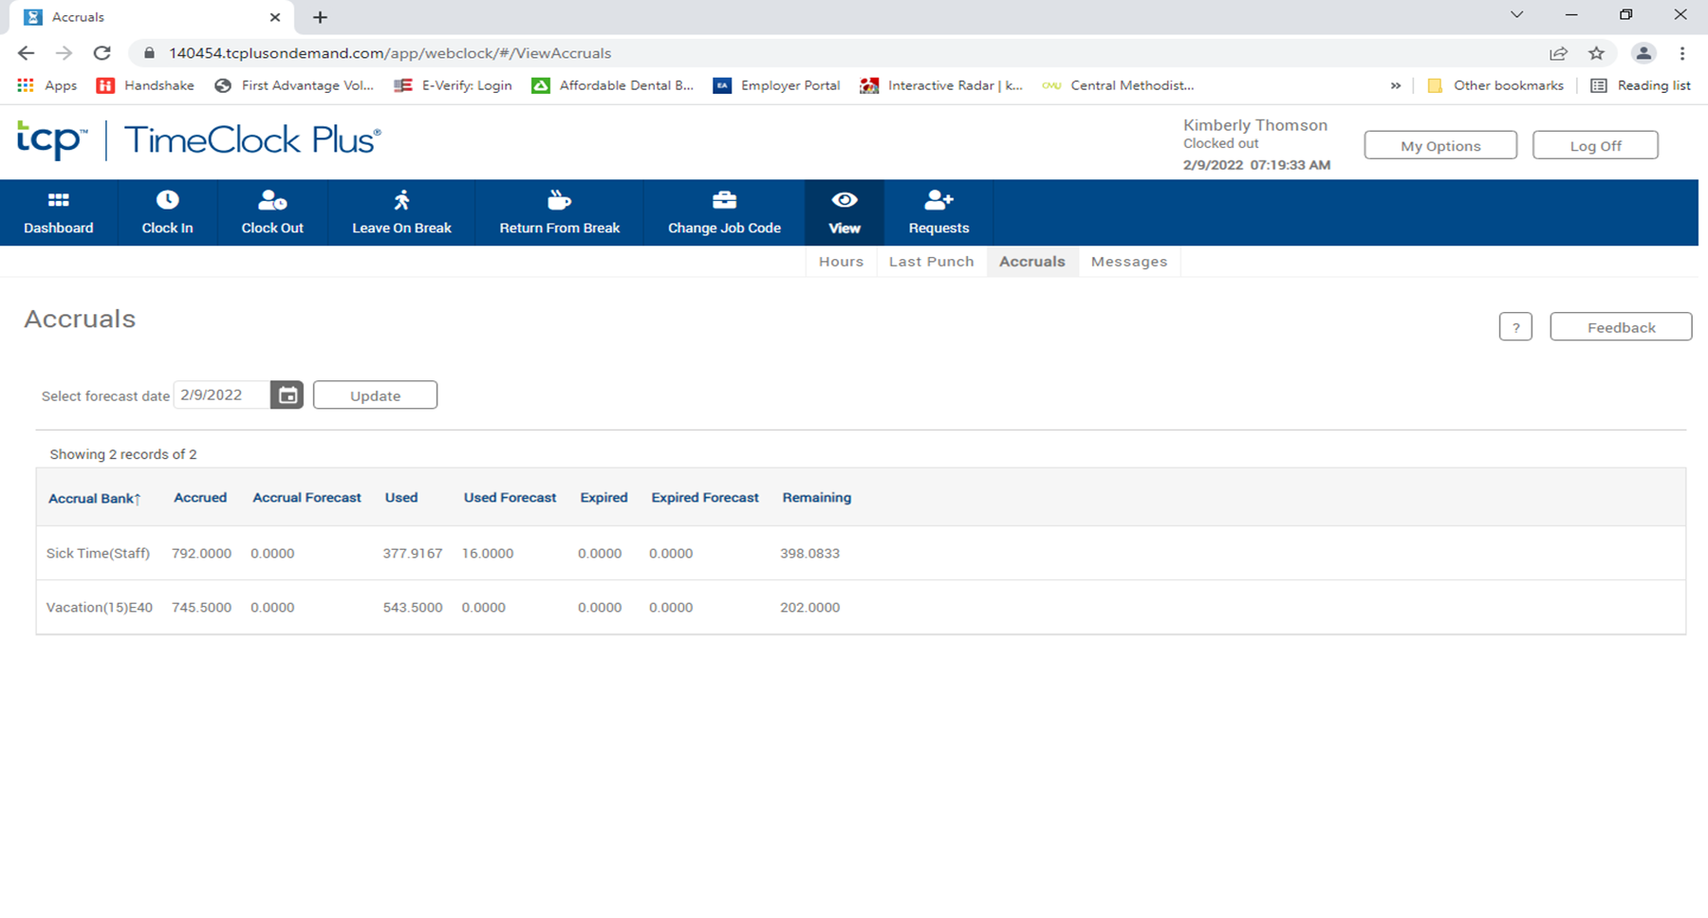
Where to locate sick /vacation days
1
2
3
Time in hours

Slide 22
Time Off: Sick Leave
Full-time staff and faculty earn sick leave as indicated below.
  Full-time employees earn sick leave at a rate of 1.25 days per month for each month worked.
    Sick leave may be used for the illness of an immediate family member, with supervisor’s approval, for up to 3 days. A doctor’s note is required after 3 days. Extensions must be approved by the VP of Finance.
Employees may accumulate sick leave up to a total of 120 working days.

Slide 23
Time Off: Vacation
Full-time staff employees earn vacation each month according to the schedule below:
Employees may accrue up to 2 times the annual accrual (ex. If an employee accrues 10 days of vacation per year, may accrue up to 20 days maximum).
Vacation time must be requested and approved prior to being away.
Job Classification | Days Per Month | Years of Service | Annual Weeks
Non-Exempt | .83 1.25 | 0-10 10 & Up | 2 weeks 3 weeks
Exempt | 1.25 1.67 | 0-10 10 & Up | 3 weeks 4 weeks
Officers | 1.67 | All | 4 weeks
Where to request time off

Slide 24
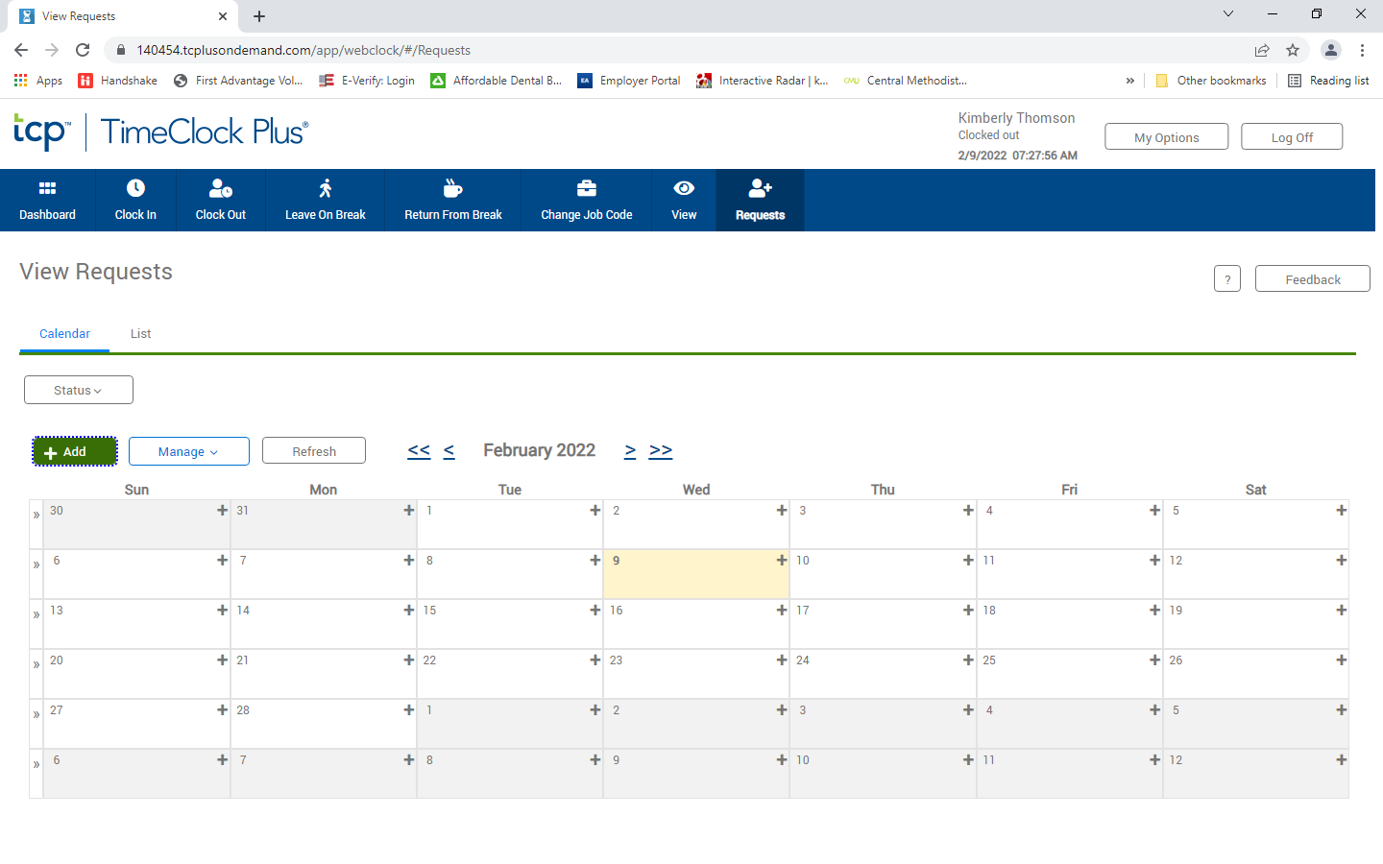
To Request Vacation/Sick Time
1
2
Back

Slide 25
Time Off: Holiday
Staff holidays are listed on the HR website.
All staff employees must be currently working 2 weeks prior and 2 weeks after the holiday to receive holiday pay.
Student/Faculty holidays are listed in the CMU Academic Catalog or in the Important Academic Dates section of the CMU Faculty Handbook.

Slide 26
Payroll by groups
Plant Operations is paid every 2 weeks on a Friday
Non-Exempt employees are paid on the 1st of the month, and their pay period is from the 21st of the month to the 20th.
Exempt employees are also paid on the 1st of the month, and their pay period is by calendar month.
Adjuncts are paid by contract/class

Slide 27
CORONAVIRUS UPDTATES
In an effort to create a safe working environment, CMU will continue to follow the 6 foot social distancing recommendations. You can view all Coronavirus updates on the CMU Website.
Coronavirus updates
Coronavirus FAQ

Slide 28

Taking Care of Business
The following forms are located on the CMU Website and are fillable, once complete please return them to HR by email. hr@centralmethodist.edu
  Personal Data Sheet
  I-9 Form
  Federal W-4
  Missouri W-4
  TB Assessment – (Faculty Only)
  Direct Deposit Authorization
  TIAA Retirement (403b)
How to create an On-line account

Slide 29
Federal W-4
Fillable Form
Sign
Additional Money withheld
Back

Slide 30
Missouri State W-4
Additional withheld
Actual Form
Sign
Back

Slide 31
Direct Deposit Form
Print
Actual Form
Sign
Back
* First check may be paper for pre-noting

Slide 32
Personal Data Sheet
Fillable Form
Back

Slide 33
TIAA Retirement 403(b)
Actual form on Website
Complete top half to participate
OPT OUT Sign Both
Back

Slide 34
I-9 Verification Form
Actual Form
1
OR
1 of each
complete
Pick 1
sign
Back

Slide 35
TB-Faculty Only
Actual Form
Back

Slide 36

Retirement
CMU offers a 403b Retirement Plan through TIAA.
  All employees are eligible to participate in the retirement program.
  Employees are eligible for CMU contributions after one year of service during which the employee completes 1,000 continuous hours or more of service.
    Eligibility may occur sooner if employee is coming directly from another higher education institution (if full time).
  CMU contributes 3% of the employee’s annual income. CMU will match 100% on the first 1% , and 50% on the next 7% the employee contributes.
  100% immediate vesting.
  Auto Enrollment at 3% and Auto escalation at 1% each year until you reach an employee contribution rate of 8%.

Slide 37
Retirement Summary
 | 2020 TIAA Retirement Plan
Employee Contribution | CMU Base Contribution | CMU Match | Total Savings Level
0% | 3% | 0% | 3%
1% | 3% | 1% | 5%
2% | 3% | 1.5% | 6.5%
3% | 3% | 2% | 8%
4% | 3% | 2.5% | 9.5%
5% | 3% | 3% | 11%
6% | 3% | 3.5% | 12.5%
7% | 3% | 4% | 14%
8% | 3% | 4.5% | 15.5%

Slide 38
CMU Systems - Phone
The CMU main telephone number is 660-248-3391 or toll free at 1-877-268-1854
All employees have a voice mail account. Directions for setting up your voice mail can be found on the Intranet under Telephone and Voice Mail.
Tech Services can have your voicemail sent to your email. You can request that through the helpdesk
To access the voice mail system while on campus, dial 69999. From off campus, dial 660-248-6999.

Slide 39
Address and Mail
The address on campus is:
    Central Methodist University
    411 CM Square
    Fayette, MO 65248
To locate your mail, consult your division chair or department supervisor.
Packages are usually delivered to the Brannock mailroom or the Student Center mailroom.

Slide 40
Resources-Communication
Need business cards? A photograph taken? Help with a brochure? Something updated on the website?
Have questions about branding standards (fonts, colors, logos, etc.)?
Do you have a news tip or need a press release sent out about an award or upcoming event?
Marketing/Communications can help with all of these needs. Contact x56238 or jwaner@centralmethodist.edu
CMU Print Services are located in the Eagle Store
printing@Centralmethodist.edu

Slide 41
Resources - Travel
Need to take a business trip? Have expenses to be reimbursed?
Business Services can assist you.
  Sign up to be an approved driver. (Business Office)
  Submit Expense Forms with detailed receipts by the 18th of the month for reimbursement on the 20th.
  Check-out a University credit card for authorized University purchases. Contact Gina Monnig (x56202)

Slide 42
Resources-Maintenance
Do you have a maintenance request (light bulb to be changed, picture to hang, etc.)?
  Send an email to Plant Operations at operations@centralmethodist.edu.
  Do you need to reserve a CMU vehicle for a University business trip?
    Send an email to Paula Boss-Wood at operations@centralmethodist.edu
  Do you need to reserve a meeting room on campus?
    See the “Scheduling Events on Campus” section of the Employee Handbook

Slide 43

CMU Systems - Email
You can access email two ways:
From your office computer using Microsoft Outlook.
  Technology Services can help you with setup and access. (1st floor of Smiley Library)
Over the web.
  Go to http://www.centralmethodist.edu/
  Click on Eagle Mail
  Enter your Eagle login and password when prompted.

Slide 44

Benefit Information
CMU full-time employees are provided with a pre-tax benefit package to complement your compensation package. Visit our Benefit Information web page to learn more about these benefits:
Health Insurance
Dental Insurance
Life Insurance
Optional Life Insurance to purchase
Long-Term Disability Insurance
Flexible Spending Accounts
Here, you will find benefit summaries explaining each plan and a link to the carrier’s website for even greater access to information about your plans.
Anthem application
Dental application
Section 7 of the Anthem Form

Slide 45
Benefit Information – Cont.
Insurance benefits begin the first of the month following 30 days of full-time employment. Insurance premiums for full-time employees are 100% paid by CMU if the employee participates in the wellness program each year. Employees may choose to pay premiums for family, spouse, or dependent coverage. Rates can be located on the CMU Website.
Rates for Benefits
Compliance Information for: COBRA HIPAA/GINA Marketplace Exchange Special Enrollment Notice WHCRA Enrollment Notice

Slide 46
Tuition Assistance
In addition to insurance and retirement, CMU provides you a tuition benefit that cannot be beat!
Full-time Employees: Covers undergraduate and graduate tuition 100% tuition free. Books and fees are the responsibility of the employee.
  Part-time employees working at least 20 hours per week are eligible after one year of continuous service for a 100% tuition waiver for undergraduate courses or 50% tuition waiver for graduate courses.
Full-time Employees may take up to 12 credit hours per semester (not to exceed one on-ground course per semester offered between 8am and 5pm). The time taken off of regular work hours to attend class must be made up at a time agreeable to the supervisor.

Slide 47

Tuition Assistance
Tuition Waiver-for family
  All dependent children (up to age 25) and spouses of full-time employees will receive a 100% tuition waiver for undergraduate courses. Room, board, fees and books are the responsibility of the employee/student.
  Spouses of full-time employees will receive a 50% tuition waiver for graduate courses.
  See Educational Assistance policy in the Employee Handbook for further information and guidelines.
  A current FAFSA must be filed prior to enrollment.
  Tuition Waiver forms are located on the CMU Website
Tuition Waiver Forms

Slide 48
Campus Life
Dining at Central Methodist University
We offer two dining options through Fresh Ideas.
    Bergsten Dining Hall
      Open for lunch 10:45am – 1:30pm
      Deli, Pizza & Salad Bar 1:30pm – 2:30pm
    Eyrie Café
      Open 7:30am – 10pm

Slide 49
Campus Life
We invite you to take advantage of the following amenities and activities on the Fayette campus:
    The Little Theatre
    Stephens Museum
    The Ashby-Hodge Gallery
    Morrison Observatory
    Swinney Conservatory of Music
    Athletic Facilities
    Exercise Facilities

Slide 50
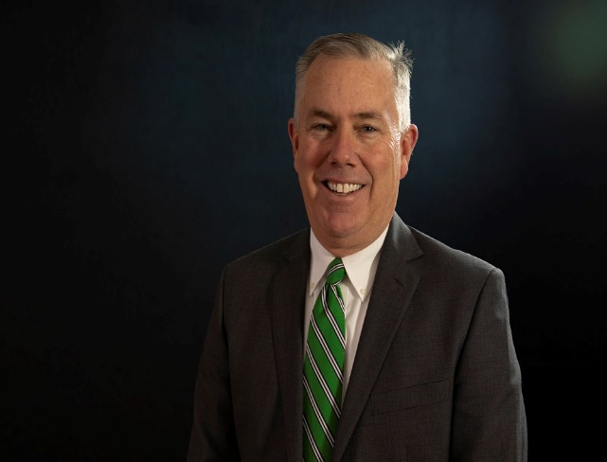
Campaign for the Heart of Central
The Advancement & Alumni Office is to cultivate relationships in a manner that strengthens the University’s future. The goal is to engage all alumni and friends to make CMU a truly special place for learning. As a private institution, the success of our university relies on the generosity of many. You are invited to support Central through your gifts of time, talent and treasure.

Slide 51
Insider Tips from Fellow Employees
Keep an eye out for sales at the Bookstore to stock up on CMU gear! – Abigail Wall, Campus Eagle Store Manager
Take a stroll through campus every once in awhile, it’s beautiful! – Tricia Hackman – Switchboard/Mailroom Supervisor
Employees, spouses and dependent children are admitted to all home CMU athletic events FREE! – Jeff Sherman, Athletics Director

Slide 52
Insider Tips from Fellow Employees
Employees can join students in a chapel service every Tuesday at 10am*! – Scotty Wall, Chaplain *with supervisor approval
Visit the Faculty and Staff Directory to help you more quickly learn and remember names and faces – Kimberly Thomson, Human Resource Director
Stay in touch with CMU happenings on Facebook and Twitter – Julee Sherman, VP of Finance & Administration

Slide 53
Insider Tips from Fellow Employees
The Library’s popular DVD collection offers free 3 day movie checkouts as well as access to other libraries around the state! – Jennifer Parsons Digital Resources Librarian
You can put $25 on your ID card at Fresh Ideas and get $30 toward your declining balance. – Sharon Cravens-Fresh Ideas
Go Green with a “to go” container for a one time charge of $5.00. It can be used in the cafeteria or the Eyrie Cafe. – Haleigh Strodtman, Payroll Manager

Slide 54
Insider Tips from Fellow Employees
There are lots of great cultural activities on campus, and most are free and open to the public. – Dori Waggoner, Director of Fine Arts and Professor of Music

Slide 55
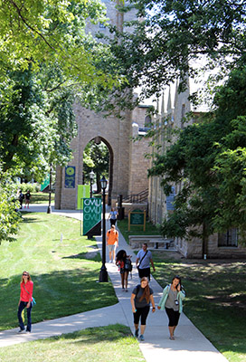
Welcome to CMU

Slide 56
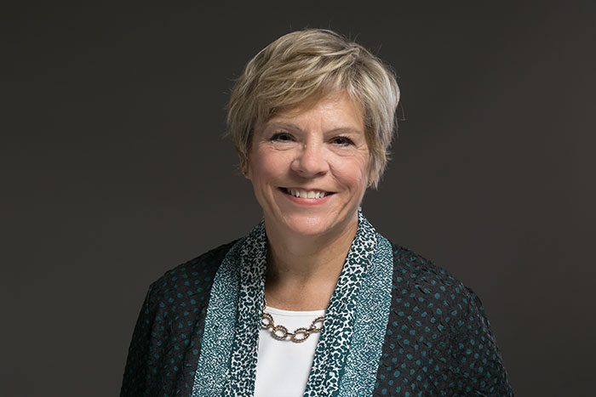
Julee Sherman
VP for Finance and Administration
Business office
Plant Operations
Human Resources
CGES Billing
Fresh Ideas
Eagle Bookstore
Back

Slide 57
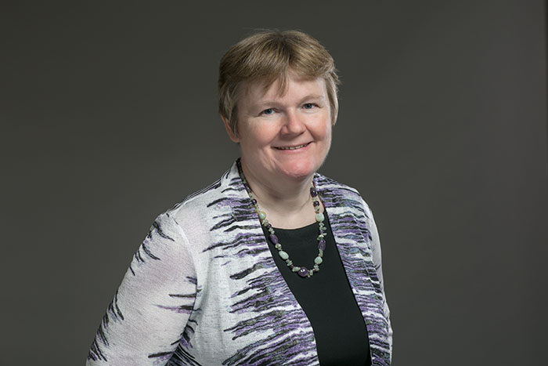
Dr. Rita Gulstad
Provost
All academic
Library
Registrar
Dual credit
CGES
On-Line
Faculty
Retention
Back

Slide 58
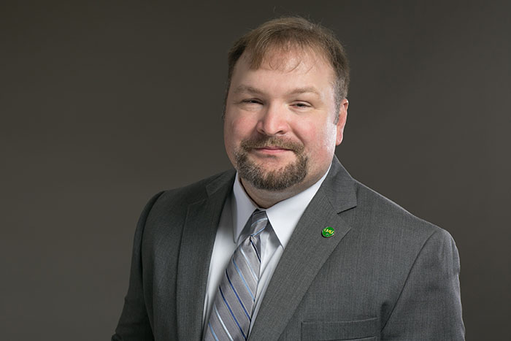
Chad Gains
VP for Information Services
Technology Services
Institutional Research
Institutional Planning
Digital U
Athletcs
e-Sports
Back

Slide 59
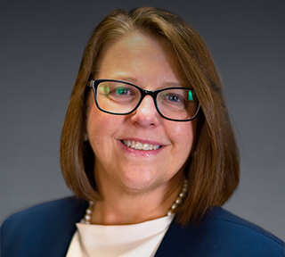
Dr. Melissa K. Mace
VP for Enrollment Management
Admissions
Marketing / Communications
Financial Service
Public Relations
Back

Slide 60

Dr. Bill Sheehan Jr
Advancement & Alumni Relations
University Advancement
Alumni Relations
Church Relations
Ashby Hodge Gallery
Career Services
Back

Slide 61
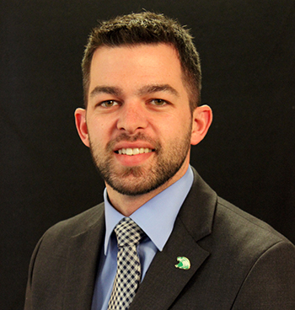
Brad Dixon
VP of Student Life
Student Development
Student Health
Back

Slide 62
Policy Comparison –HMO/PPO/HSA
Anthem Blue Cross Blue Shield: HMO, PPO and HDHP Medical Plans
Network | Blue Preferred | Blue Access | Blue Access
Plans | HMO | PPO | HDHP / HSA
Deductible: Individual | No Deductible | $1,500 | $2,600
Deductible: Family | No Deductible | $3,000 | $5,200
Co-Insurance | 10% on select services | 20% After Deductible | 0% After Deductible
Out of Pocket Maximum: Individual | $3,250 | $3,000 | $2,600
Out of Pocket Maximum: Family | $6,500 | $6,000 | $5,200
Preventive Care | Covered at 100% | Covered at 100% | Covered at 100%
Office Visit (PCP / Specialist) | $35 Co-pay/$45 Co-pay | $35 Co-pay/$45 Co-pay | Deductible
Urgent Care | $45 Co-pay | Deductible & 20% | Deductible
Emergency Room | $200 Co-pay | Deductible & 20% | Deductible
Hospital: Inpatient or Outpatient | $500 Co-pay or $250 Co-pay | Deductible & 20% | Deductible
Retail Prescriptions (30 day supply) | $10/$45/$75 | $10/$45/75 | Deductible then Covered at 100%
Mail Order Prescriptions (90 day supply) | $20/$90/$150 | $20/$90/$150 | Deductible then Covered at 100%
Specialty Prescriptions (30 day supply) | 25% | 25% | Deductible then Covered at 100%
Click here
Click here
Click here
Benefit Wallet: Health Savings Account | 2020
Single | $3,400
Family | $6,850
Catch Up: 55 + | $1,000
Back

Slide 63
Pick 1
Your Info

Slide 64
Delta Dental Overview
Dental Overview
Back

Slide 65
CMU Website #1
Employees who have an annual salary over $30,000 are Class 1-$50,000
*****
Employees who have an annual salary under $30,000 are Class 2-$35,000
CMU Website #2
Back

Slide 66
Long Term Disability
LTD Overview
60% of pay
180 Days
Back

